Slide 1
Water Services Authorities Summit
Skills Development

Slide 2
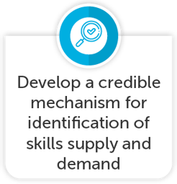
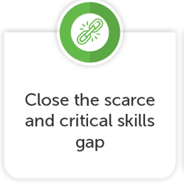
INCLUSIVE ECONOMIC PARTICIPATION

Slide 3
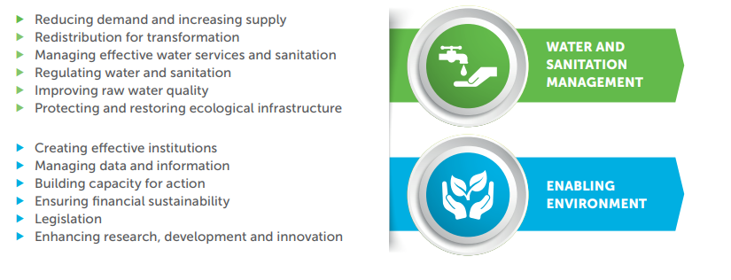
Strategic Focus: SETA’s Key Priorities
National Water & Sanitation Master Plan

Slide 4
Skills Development Challenges
Fragmented Skills Development (in orgs and nationally)
Research and Innovation
Poor skills Planning by Human Resources in organisations
Timely relevant qualifications development
Availability of credible and qualified skills development providers
Continuous Professional development
R
NO RETURN ON INVESTMENT

Slide 5
Energy Skills Report

Slide 6
WAY FORWARD
Coordinate water sector skills development
Reviewing the learning pathways for service delivery areas relating to Water and Sanitation and possible specialisation areas (Competency Framework in the Municipal Staff Regulations).
Using the District Development Model (DDM) to implement Water and Sanitation projects and identify strategic partnerships for priorities.
Collaborate and coordinate on occupational shortages (scarce skills) and skills gaps (critical skills/top-up skills) relating to Water and Sanitation. Working
Collaboratively through Provincial Skills Development/HR related Forums to ensure regular strategic conversations on ways to address water service delivery areas: promoting collaboration, communication, integration, coordination, accountability and integrated service delivery.
Regulation 3630

Slide 7
THANK YOU

